Slide 1
Problems in Cloud Computing
By
Maniratnam Palkur
Naveen Kumar Challa
Pradeep Vemuganti
Siva Sai Eruboyana

Slide 2
Flow Of Presentation:-
What is Cloud Computing?
Need Of Cloud Computing!
Architectural Overview of Cloud Computing.
Cloud Models.
Deployment Models.
Service Models.
Software as a service(SAAS)
Platform as a service (PAAS)
Infrastructure as a service (IAAS)
Data as a service (DAAS)
Problems in cloud Computing.
Solution to Security problems.
Future Work.
Conclusion.
References.

Slide 3
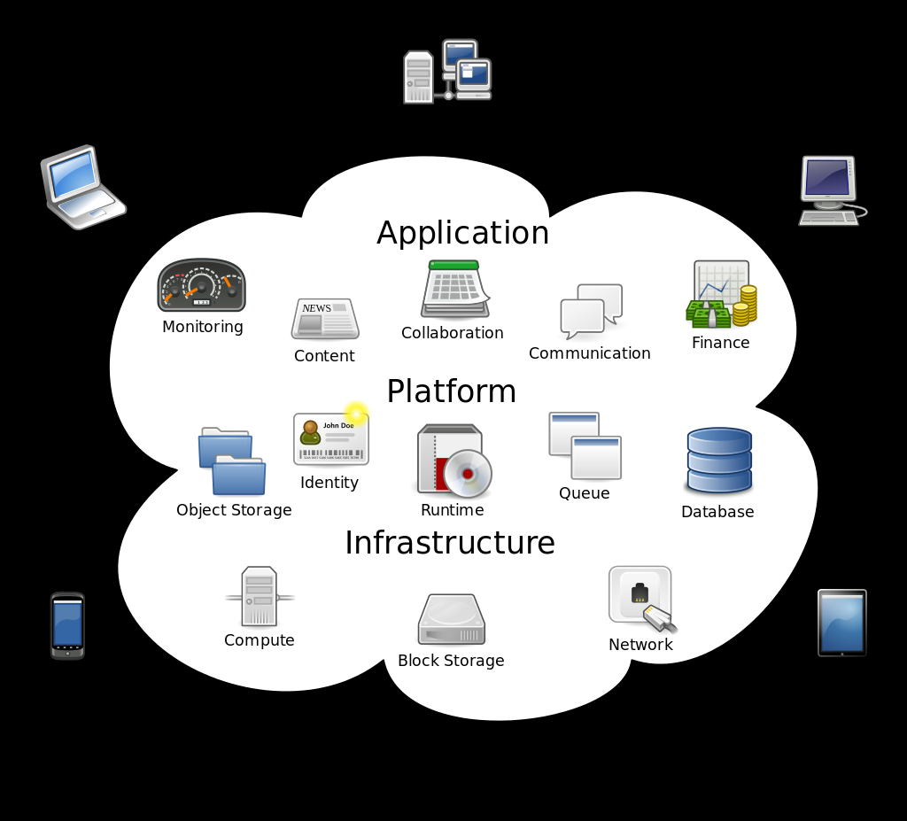
What is cloud computing?
In the simple terms the cloud computing is storing and accessing the data or programs over the internet instead of doing it on the personal computer.
Cloud computing is completely a new technology which Leads to performing the tasks only with the help of the Internet. There is no need of physical storage for performing any task, if we have the access to cloud computing with the help of internet.
Cloud computing is a new way of delivering computing resources, as a public utility.
Computing services refers to data storage, email handling are now available directly and on-demand.

Slide 4
Need of cloud computing !
There are four basic things people are doing in the cloud:
Machines in the cloud.
Storage in the cloud.
Databases in the cloud.
Applications in the cloud.
In addition to these four basics, cloud providers offer other services such as message queues and data mining.

Slide 5
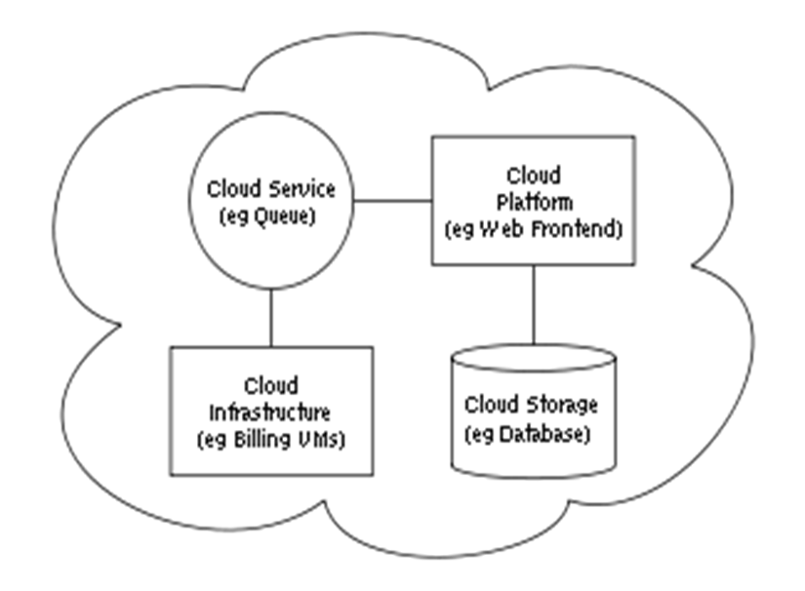
Architectural overview of Cloud computing :-
Two most significant components in the architecture of cloud computing are,
1. Front end &
2. Back end.

Slide 6
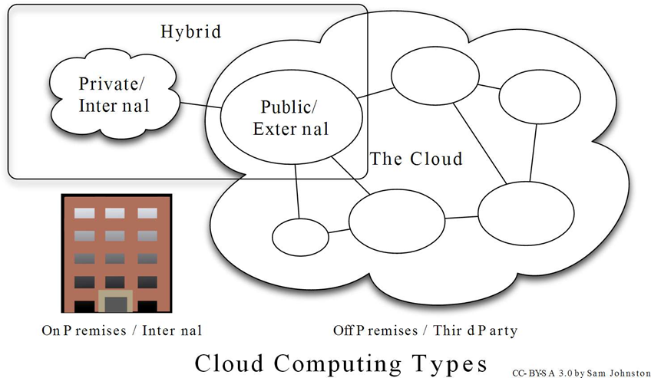
Cloud Models:- Deployment Models:-
There are four deployment models.
Public Cloud.
Community Cloud.
Hybrid Cloud.
Private Cloud.

Slide 7
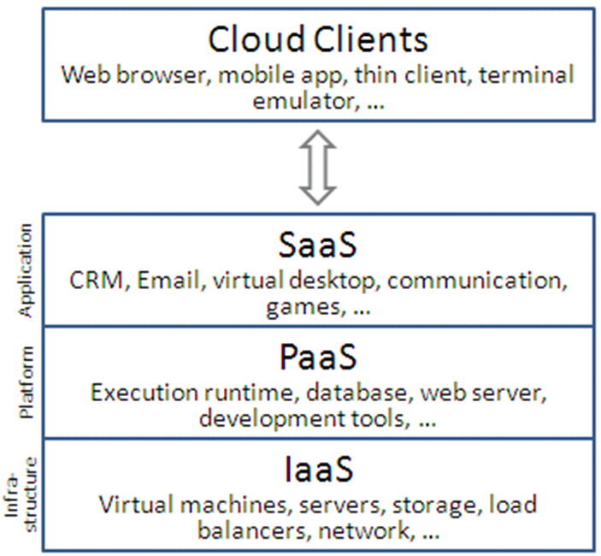
Service Models:-
Software as a service (SAAS).
Platform as a service (PAAS).
Infrastructure as a service (IAAS).
Data as a service (DAAS).

Slide 8
Software as a service(SAAS): -
SAAS is also referred as a Application or a Service Clouds. It is the model which hosts the application as a service to its various cloud users via internet.
It can reduce the total cost of hardware and software development, maintenance, and operations.
The applications can be accessible from various client devices like iPad, smartphone, laptop, Medical Clinical Assistant (MCA) or PCs.
In SAAS, we have a issue like if a particular user needs the same file which is being used by another user at the same time but due to security measures the user cannot get that file.
SAAS can be divided into two ways,
1. Vertical SAAS.
2. Horizontal SAAS.

Slide 9
Platform as a service(PAAS):-
It supplies all the needed resources to build an application and service via the internet, without downloading or installing it.
PAAS reduces the cost and complexity of buying, housing, and managing hardware and software components of the platform.
The only difference between SAAS and PAAS is, SAAS only hosts the completed applications whereas PAAS allows both completed applications and also the applications in-progress.
PAAS is most helpful for the developers, it allows a developer to frequently change or upgrade the application features and it is helpful for the development teams to collaborate on their projects.

Slide 10
Infrastructure as a service(IAAS):-
Infrastructure as a Service (IaaS) is referred as ‘Resource Clouds’, they normally manage the resources which are provided to the users as a service and they can scale up easily.
The providers usually bill the resources which are given to a users on the basis of computational method.
It enables a software deployment model in which the basic computing infrastructure of servers, software, and network equipment is provided as an on-demand service upon which a platform to develop and execute applications can be founded.
Service provider owns the equipment and is responsible for housing, running and maintaining it.
Virtualization is extensively used in IaaS cloud in order to integrate/decompose physical resources in a way to meet the growing or shrinking resource demand from cloud consumers.

Slide 11
Data as a service(DAAS) :-
Data as service(DAAS) are similar to the software as service(SAAS).
DAAS is a service provider that enables data access on demand to users even without considering their geographic location.
DAAS is a emerging technology which helps in the web services and structured oriented architectures.
DAAS allows consumers to pay for what they are actually using rather than the site license for the entire database.
The large amount of data access is primarily controlled through the data services by itself, this increases the quality of the data.
In DAAS, privacy and security concerns are important because the data that is stored in it is associated with development of an organization.

Slide 12
Problems in Cloud Computing:-
These are the few problems normally occurs:-
Data issues
Privacy Policy issues
Legal problems
Technical security problems
In addition to this problems we also have,
Loss of control in the cloud.
Lack of trust in the cloud.

Slide 13
Data issues:-
Data Access Control: -
Due to lack the of secured data access control confidentiality of the data can be illegally accessed.
It is risk, if a data exists in cloud for long period by the unauthorized access.
Data Location: -
The vendor doesn’t reveal the location where the data is stored, even to the customer where his own data is located.
Data Loss:-
This is a very serious problem in cloud computing.
If a vendor is shut down by some legal or other problems, customer doesn’t get back his data.
Even if everything is secure, if the server goes down or attacked by a virus data will be lost.

Slide 14
Privacy policy Issues:-
Data integrity:-
Cloud system means to preserve information integrity (i.e., not lost or modified by unauthorized users).
Corruption in the data can happen at any level of storage and with any type of media, So Integrity monitoring is essential in cloud storage.
Data Security: -
In order to achieve the data security and data integrity, Hypertext Transfer Protocol Secure (HTTPS) and Secure Shell (SSH) are the most common adoption.
In Cloud Computing most used communication protocol is Hypertext Transfer Protocol Secure(HTTPS).
Data Privacy: -
This is one of the primary concerns in cloud computing, Cloud should create a committee to a accurate decisions related to the requirements of the data privacy.

Slide 15
Legal Problems:-
• Liability
• Security
• Risk allocation
• Date Retention Issues
• 3rd party contractual limitations
• Regulatory compliances
• Control over physical location of the data
• Security breach
• Trade secret protection
• Hacking of cloud provider
• Financial liability of cloud vendor
• Legal/practical liability for force majeure events
• IPR issues
• Jurisdiction and court of law

Slide 16
Technical Security Problems:-
XML signature attack
Browser security
Cloud malware injection security
Flooding attacks

Slide 17
XML signature attack:-
There are many protocols that use this XML signature
It is mainly used for authentication and Integrity
Lets take an example, Lets say the sender sends a message to the receiver here the actual message is sent in the body of message then it is signed for the authentication so that the receiver checks it and receive the message.
The attacker can identify the message stored in the form of pointer and he can modify the message

Slide 18
Browser security:-
The main feature of cloud computing is we can access the data from any where. For authentication the browser is the main key.
We depend on the third party server for the authentication and encryption of data so for the data the browser acts as a passive storage.
The browser cannot understand the encryption so it utilizes the third party for the retrieving of data which may lead to the data loss

Slide 19
Cloud malware injection security:-
It mainly aims at injecting the malicious service implementation into cloud system.
This type of attack serves for a particular purpose which may lead to data modification.
There is a risk of full change in the entire cloud functionality.
To avoid this there would be a need of adding virtual machine instance to the cloud system.

Slide 20
Flooding attacks:-
In the cloud system the server provides the data to the users.
The users sent the requests to the server and when the requested are overloaded there might be a possibility of sending the wrong information.
There would also be a possibility of send the information with delay.
So there should a proper servicing or maintenance of the server to avoid flooding attacks.

Slide 21
Lack of Trust in the cloud:-
The trust mainly comes into play while taking the risks.
In cloud computing we depend on the third party for many reasons as explained earlier by an example using the browser
Data location is also a critical factor in cloud computing. There would be lot of problems in the data storage and retrieving the same data.

Slide 22
Lack of control in the cloud:-
It generally means that there is a chance of loosing control over data or loosing control over functionality, when it comes to business users there might be a problem of loosing control over assets etc.
Here in cloud computing the server is owned by a single person and it is utilized by the multiple users. So if the maintenance of the server plays and important role in managing all the data.
If not there could be loosing control over the cloud which leads to huge loss.
Generally, consumer depends provider to ensure,
Data security and Privacy.
Resource availability.
Repairing of services.

Slide 23
Solutions to security issues
Trust between the service provider and customer.
Make sure the customers personal devices are secured enough while getting connected to the cloud.
Data splitting is also a solution for cloud security issues.
Using digital signatures while authenticating also resolves the security problems.
Preserving the integrity as well as the confidentiality is also one of the major issue.

Slide 24
Future Work:-
Right now we are in early stages of cloud computing. Experts says that by 2020 it would occupy the whole IT and acts as a backbone of every organization
Cloud computing would definitely earns all the attention because the hardware is going to fly and stored in the cloud as a virtual.
There would be no need of large data storage hard wares in the industries there are researches going on to come over the security issues and to develop a complete automated cloud in near future.
One thing is sure the software sooner floats away from hardware

Slide 25
Conclusion:-
This presentation we discussed about the cloud computing and its architecture, and its models along with the problems that occurs in cloud computing .
In developing the solutions to the problems in cloud computing , it may be helpful to identify the issues and approaches in terms of,
* Loss of Control.
* Lack of Trust. &
* Data Security.
Hence we conclude,that this issues comes consider whenever we consider it with big level companies , they are not going to affect much more as single user.

Slide 26
References:-
Kumar, Santosh. "Cloud Computing – Research Issues, Challenges, Architecture, Platforms and Applications: A Survey." International Journal of Future Computer and Communication 4th ser. 1 (2012): n. pag. Web.
Padhy, Rabi Prasad, and Manas Ranjan Patra. "Cloud Computing: Security Issues and Research Challenges." International Journal of Computer Science and Information Technology & Security (IJCSITS) 2nd ser. 1 (2011): n. pag. Web.
Parekh, Disha H., and Sridaran R. "International Journal of Advanced Computer Science and Applications,." An Analysis of Security Challenges in Cloud Computing 1st ser. 4 (2013): n. pag. Web.
Navdeep, Singh. "A Review on Security Issues in Cloud Computing." International Journal of Innovation and Applied Studies 3rd ser. 8 (2014): n. pag. Web.
Wassim, Itani, and Kayssi Ayman. "Privacy as a Service: Privacy-Aware Data Storage and Processing in Cloud Computing Architectures." 2009 Eighth IEEE International Conference on Dependable, Autonomic and Secure Computing (2009): n. pag. Web.

Slide 27
VMeiko, Jensen, and Gruschka Nils. "On Technical Security Issues in Cloud Computing." 2009 IEEE International Conference on Cloud Computing(2010): n. pag. Web.
Vijay, Kumar. "Brief Review on Cloud Computing." International Journal of Computer Science and Mobile Computing 5.9 (2016): n. pag. Web.
"Cloud Computing Security Case Studies and Research." Proceedings of the World Congress on Engineering 2013 2 (2013): n. pag. Web.

Slide 28
Thank you

